Slide 1
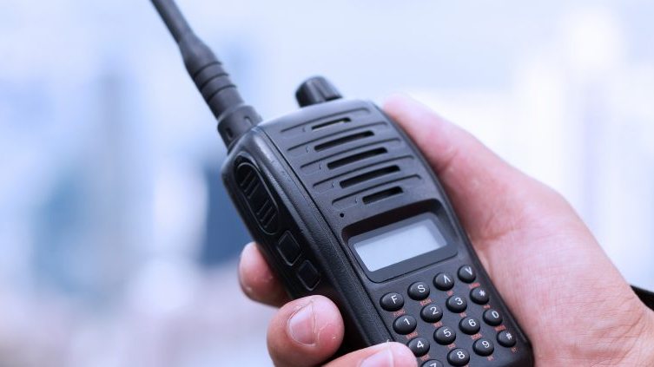
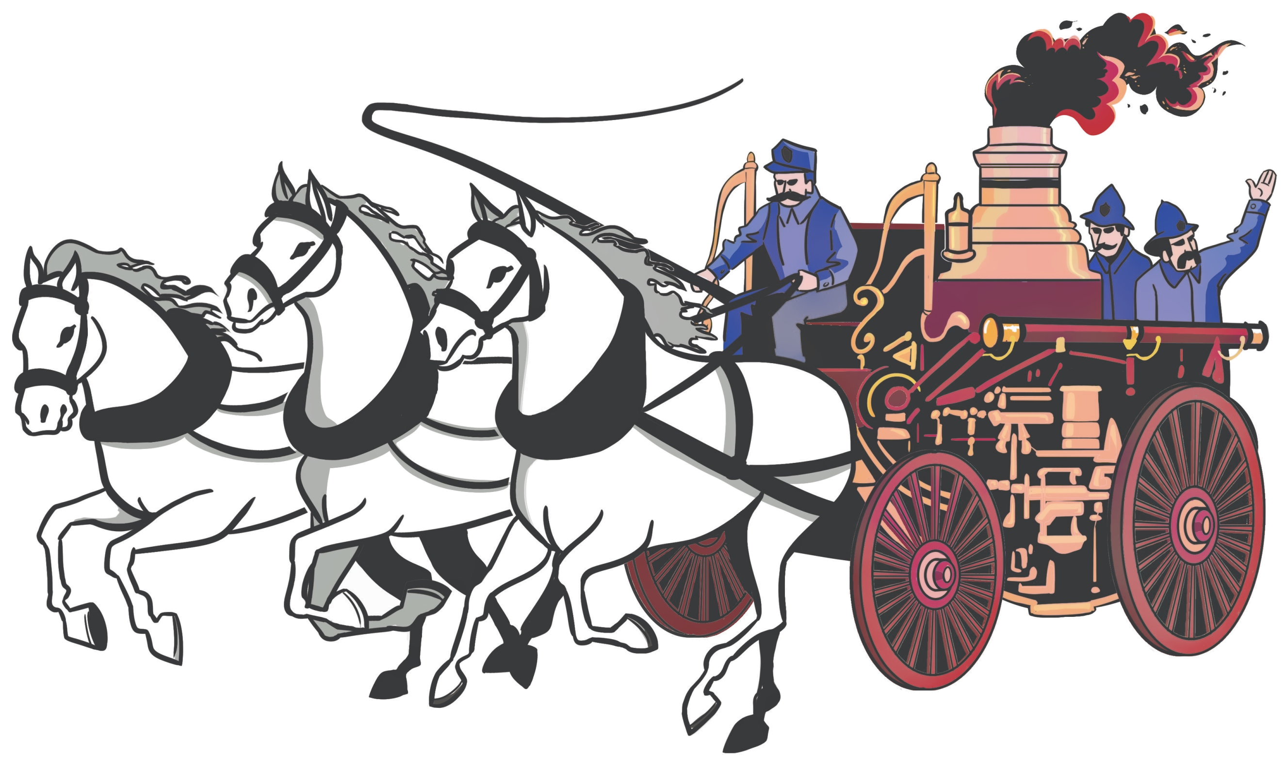
SCANNER TRAINING
Jeremiah Norrell, FF & EMT
Georgetown Fire Department

Slide 2
NCLUDED WITH YOUR SCANNER
BC125AT scanner with attached belt clip
Antenna
Rechargeable Ni-MH Batteries
USB cable
Wrist strap
Connecting the Antenna
Align the slots around the antenna's connector with the tabs on the scanner's BNC connector.
2. Slide the antenna's connector down over the scanner's connector.
3. Rotate the antenna connector's outer ring clockwise until it locks into place.

Slide 3
BEARCAT BC125AT
What’s Scanning?
Power On / Volume / Backlight
Change Channel
Hold/Scan
Lockout
Channel Banks
Unlike standard AM or FM radio stations, most two-way communications do not transmit continuously. Your BC125AT scans programmed channels until it finds an active frequency, then stops on that frequency and remains on that channel as long as the transmission continues. When the transmission ends, the scanning cycle resumes until the scanner receives another transmission.

Slide 4
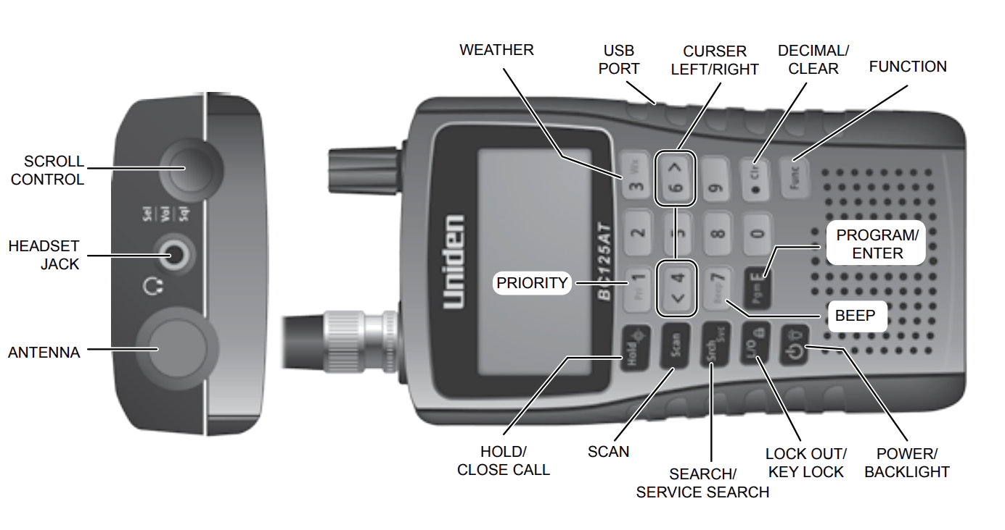
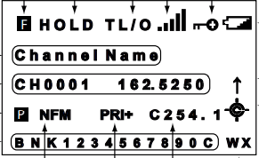
UNDERSTAND THE SCANNER

Slide 5
POWERING THE SCANNER
You can power the scanner using alkaline (ALK) non-rechargeable batteries (not supplied) or the included Nickel Metal-Hydride (Ni-MH) rechargeable batteries.
USB cable provided to charge the Ni-MH batteries on initial installation and to recharge them through your computer or power adapter (not included)
Inside the battery compartment is a switch to set the unit to either ALK or Ni-MH.
Warning! Non-rechargeable batteries can get hot or burst if you try to recharge them.
Be sure the scanner is turned off. It will recharge only if it is turned off, even with the USB cable connecting it to a computer

Slide 6
ADJUSTING THE VOLUME
1. Press Scroll Control; The volume level indicator and battery voltage display.
2. Turn Scroll Control to adjust the volume level from 0 to 15.
3. Press Scroll Control to set the volume.
4. To exit Volume Level mode, press Scroll Control again or wait 10 seconds to return to the previous mode.

Slide 7
BACKLIGHT
Press POWER/BACKLIGHT to turn on the backlight on and off.
1. Press Func and to view the Display/Charge menu.
2. From this menu, scroll to Set Backlight from the submenus. Press SCROLL CONTROL.
3. Scroll to select one of the following settings:
  • Always Off - Backlight is always off.
  • Always On – Backlight is always on.
  • On with Squelch - Backlight is on while squelch is open and until delay expires.
  • On with Keypress - Backlight is on for 10 seconds after any key is pressed.
  • Keypress+Squelch – Both above-mentioned "Squelch" and "Keypress.“
  • < Back - Return to previous menu.
4. Press Pgm/E (or press SCROLL CONTROL) to save and return to the previous menu. (Default = Always Off)
5. Press . Clr to exit.

Slide 8
SCANNING STORED CHANNELS
Press Scan to begin scanning channels.
The scanner scans through all unlocked channels in the enabled banks in channel order. When the scanner finds a transmission, it stops on it.

Slide 9
MANUALLY SELECTING A CHANNEL
You can continuously monitor a single channel without scanning.
This is useful if you hear an emergency broadcast on a channel or if you want to monitor a specific channel.
  1. To manually select a channel, press Hold and enter the channel number.
  2. Press Hold again.

Slide 10
LOCKING OUT CHANNELS
You can increase the scanning speed by locking out channels that have a continuous transmission such as a weather channel.
While receiving a channel or while in Scan Hold mode, press L/O once to temporarily lock out the channel. Temporary L/O and TL/O briefly appear in the display. Turning the scanner off clears the temporary lockout.
Press L/O twice quickly to permanently lock out the channel. Locked Out and L/O briefly appear in the display. Turning the scanner off will NOT clear the lockout.
If you lock out a channel in Scan mode, the scanner will resume scanning from the next channel.

Slide 11
LOCKING OUT CHANNELS
To Lock Out a Specific Channel
  1. Press Hold.
  2. Enter the channel number you want to lock out and press Hold again. (You can also press Hold and scroll to the channel.)
  3. Press L/O once to temporarily lockout or press L/O twice quickly to permanently lock out the channel.
  Note: You can still manually select locked-out channels. If you lock out all channels in the selected bank, the scanner displays All Locked! on the second line.
Unlocking Channels
  1. Press Hold.
  2. Enter the channel number you want to unlock and press Hold again. (You can also press Hold and scroll to the channel.)
  3. Press L/O.
    L/O (or TL/O) disappears.

Slide 12
UNDERSTANDING BANKS
To make it easier to identify and select the channels you want to listen to, the 500 channels are divided into 10 channel storage banks containing 50 channels each.
You could use each channel storage bank to group frequencies by department, location, area of interest, or any other way you prefer.
You can listen to any or all of the banks by using the number keys to turn them on or off.

Slide 13
UNDERSTANDING BANKS
Bank 1 – West Slope Fire Dispatch & Command
Fire Dispatch (Priority)– All El Dorado & Amador County west slope fire & EMS dispatch
Fire Command – All traffic once units are dispatched and either en-route or on scene
USFS Fire – US Forest Service fire traffic once units are dispatched and either en-route or on scene
Bank 2 – El Dorado Law Enforcement
EDSO – El Dorado County Sheriff Department Main Channel
USFS Law – US Forest Service Law Enforcement
CHP GREEN – California Highway Patrol Placerville/Auburn/Grass Valley
Bank 3 – Aircraft, EMS & Fire
CALCORD – Air Ambulance traffic between ground units and aircraft
CDF AIR/GROUND 1, 2, 3 – Air to Ground traffic on CAL FIRE Incidents
AIR/GROUND 14, 59 – Air to Ground traffic on USFS Incidents
Bank 4 – Tactical – Fires & Traffic Collisions
CDF TAC 2, 5, 8, 9 – CAL FIRE tactical channels
VFIRE 21-26 – Incident tactical channels
USFS Tac 4-5 – US Forest Service tactical channels
NIFC TAC 1-3,5-7 – National Interagency Fire Center Tactical channels
Tactical channels are used for units at a scene to communicate with each other. You will only hear this traffic if you are in range of units at scene. Usually only about 1 mile range.
Bank 5 – Weather
WX 1-6 – Weather Channels – Channel will broadcast weather continuously for your area. Using bank 5 will cause scanner to lock onto weather until bank is disabled.
Bank 6 – CALFIRE Command Repeater Network
CALFIRE CMD 1-4,6-12 – Major incidents (large fires) will typically move to this repeater network for command traffic.
Bank 7 – Amateur Radio
805 Repeater – High Sierra 805 repeater with link into Rubicon trail area. Used frequently for emergency coordination by amateur radio operators in the back country.

Slide 14
UNDERSTANDING BANKS
Enabled scan banks appear on the lowest line.
Disabled scan bank numbers are not displayed.
The currently scanned bank number flashes.
You can turn scan banks on/off by pressing 1-9 or 0, but one scan bank must always be enabled.
If you turn off all scan banks, the scanner will display Nothing to Scan.

Slide 15
QUESTIONS?

